Slide 1

Artificial Intelligence and Its Applications: Shaping the Future of Technology in Tanzania
Dr Michael S. Mollel (PhD)
Co-Founder & CEO Sartify LLC

Slide 2
Overview of the Presentation
Context and Understanding
Introduction
Understanding Artificial Intelligence
Current State of AI Globally
AI in Tanzania
AI in Tanzania: Current Landscape
Applications of AI in Tanzania
Benefits of AI for Tanzanian Society
Challenges and Ethical Considerations
Strategies for Advancing AI in Tanzania
Case Studies and Success Stories
Future Outlook
Conclusion
Notes:
Slide 2: Welcome and Opening Remarks
A very warm welcome to all of you present here today for this insightful presentation on "Artificial Intelligence and Its Applications: Shaping the Future of Technology in Tanzania."
It is my honor to have the opportunity to discuss this highly relevant and transformative field that holds immense potential for driving technological advancements and economic growth in our nation.
Artificial Intelligence, or AI, has rapidly evolved from a theoretical concept to a powerful technology that is reshaping industries, businesses, and our daily lives.
In this presentation, we will explore the fundamentals of AI, its current applications across various domains, and its potential impact on Tanzania's technological landscape.
We will delve into the opportunities and challenges presented by AI, and how we, as a nation, can harness its capabilities to drive innovation, efficiency, and sustainable development.
By understanding the capabilities and implications of AI, we can better prepare ourselves to embrace this disruptive technology and position Tanzania as a leader in the digital revolution.
I encourage you all to engage actively throughout the presentation, as your insights and perspectives will contribute to a deeper understanding of this fascinating topic.

Slide 3
Introduction

Slide 4


About Sartify
+
Co-Founder & CE0
Co-Founder & CAIO
PhD in Information Communication Science and Engineering from NM-AIST & UOG. Experience in AI, ML, and 5G wireless communications. Senior Researcher at the University of Glasgow. Received multiple awards - PhD Research Award from NM-AIST and the IEEE WCNC Best Paper Award. Email:michael.mollel@sartify.com
Innocent Charles, BSc in Software Engineering UDOM. Experience in AI, ML, and software development. Significantly contributed to AI-powered notification systems, recommendation engines, and AI resume parsers. Recognized for his achievements in competitive AI, ranking top in Zindi. Email:innocent@sartify.com

Slide 5
About Sartify
About Sartify LLC
A deep AI technology company specializing in consultation, research, and AI-powered products
Delivers customized AI decision-making solutions for enterprises and consumers
Helps clients enhance customer experience, increase efficiency, reduce costs, boost revenue, and drive exponential growth
Offerings
Custom ML/AI Engineering (Computer Vision, NLP, Recommender Systems, etc.)
Advanced Data Analytics (Business Insights, Predictive Modeling, BI Dashboards)
Data & AI Strategy Consultation (Data Governance, AI Roadmap, Change Management)
AI Executive Training (Workshops, Business Opportunities, Talent Acquisition)

Slide 6
About Sartify
Some of our works
Resume Parsing & Jobs Recommendations - Niajiri Platform Limited.
Customer’s Assistant ChatBot - AwamuPay.
Semantic Powered Search Feature & Products List Personalization - Biashara Plus Limited.
Some onprogress works
Docipro: Intelligent Document Processing Autopilot.
Fotopic: AI-powered photographic App.
Resuma Platform: Brainstorm, Craft Profesional CV
Some of Research
Open Source various Swahili AI systems
AviLaMa: African Vision-Languages Pre-Training Model.
Swahili AI Evaluation Benchmark Platform.
African Languages Datasets to power various AI research & development in Africa.
Reach Us
www.sartify.com
https://www.sartify.com/contact-us
info@sartify.com
Notes:
Enterprise Custom Solutions:
Resume Parsing & Jobs Recommendations, Niajiri Platform Limited.
Customer’s Assistant ChatBot, AwamuPay.
iPFGPT - RAG Based System For iPF Softwares, iPF SOftwares.
Semantic Powered Search Feature & Products List Personalization, Biashara Plus Limited.
Research:
Open Source various Fine-tuned LLM for Swahili Language Example. Swahili Gemma, Llama, Mixtral etc.
AviLaMa : African Vision-Languages Pre-Training Model. [Learn Visual Concepts Directly From African Language Supervision, A work towards zero shot image retrieval and ranking tasks, zero image classification, visual QA & Conversational AI, Art & Image generation guiding & condition task, text image analysis and content moderation all done in our African Languages. ]
African Languages Datasets to power various LLM research & development in Africa.
A Cassava Categorization Way (Detection & Classification) with AI.
Swahili LLM Evaluation Benchmark Platform.
Our Current In-House Developing Products: Welcome to Join a Waitlist.
Docipro : Intelligent Document Processing Autopilot, a way to uncover valuable insights effortless from any unstructured data within complex manual business workflow- Powered by AI.
Fotopic : AI-powered photographic App. Instantly get quality photographic pictures for your single phone-taken photo. This cover different variations, lookings environment, clothes etc…
Resuma Platfrom : Brainstorm, Craft Profesional CV & Get your desired Job Instantly, all powered by AI (Docipro & Conversional AI).

Slide 7
Understanding Artificial Intelligence

Slide 8

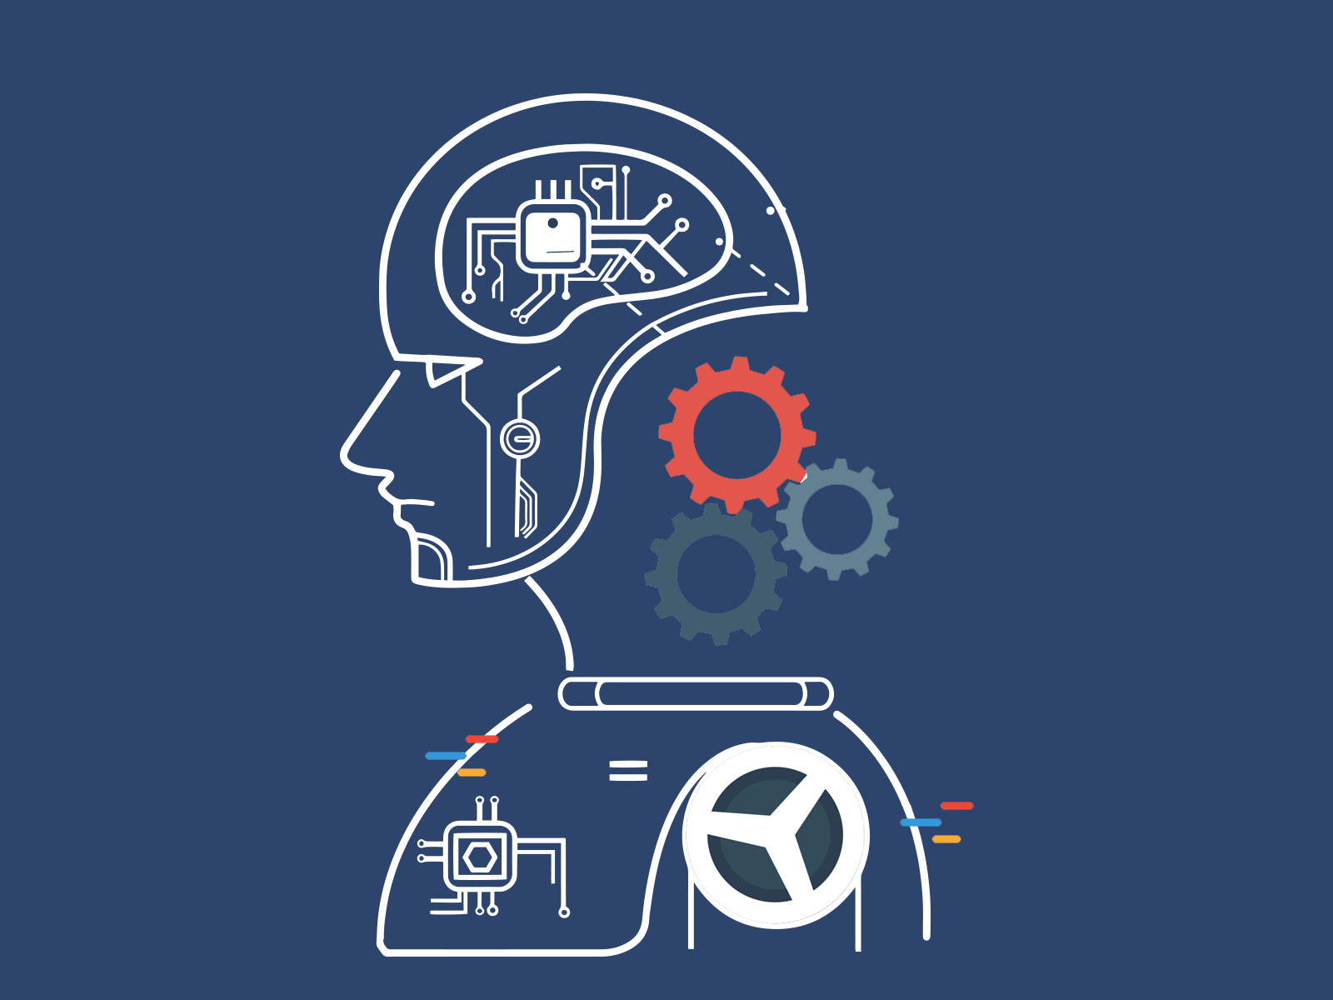
Definition and Basic Concepts
AI refers to the simulation of human intelligence processes by machines, particularly computer systems.
It involves developing systems that can perform tasks that typically require human intelligence, such as reasoning, learning, problem-solving, perception, and decision-making.

Slide 9
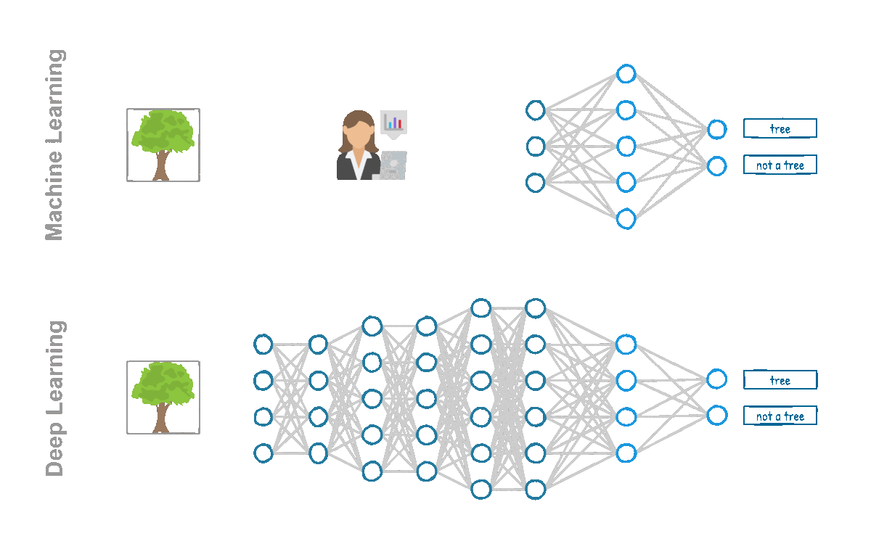
Definition and Basic Concepts
Key Concepts
Machine Learning: A subset of AI that enables systems to learn and improve from experience without being explicitly programmed. It uses algorithms and statistical models to analyze data and identify patterns.
Learning algorithms include Decision Tree, Random Forest, Support Vector Machine (SVM), Naive Bayes, Linear Regression, Neural Networks, etc.,

Slide 10
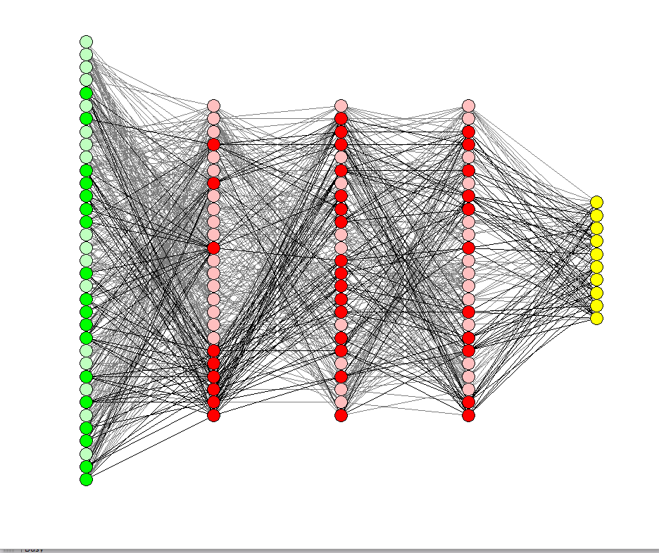
Definition and Basic Concepts
Key Concepts
Neural Networks: Computational models inspired by the human brain's interconnected neurons. Consists of interlinked nodes (artificial neurons) that transmit signals and learn to recognize patterns. Form the backbone of Deep Learning algorithms.
Input
Output

Slide 11
Definition and Basic Concepts
Key Concepts
Deep Learning: A sophisticated form of Machine Learning inspired by the human brain's neural networks. Uses multi-layered artificial neural networks to learn from vast amounts of data. Excels in tasks like image and speech recognition and natural language processing.

Slide 12
History and Evolution of AI

Slide 13
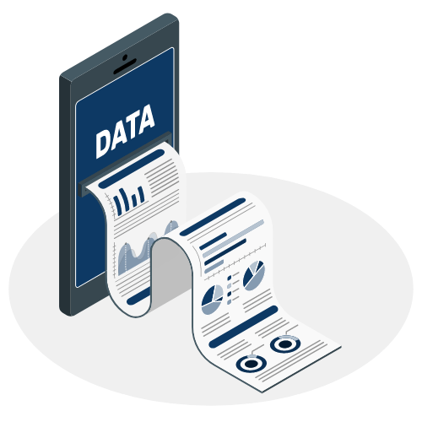

Key Components of AI
Data: They can be structured (databases) or unstructured (images, text, audio). AI systems rely heavily on data for training and decision-making. Quality and quantity of data are crucial for effective AI models.
Algorithms: are the mathematical models and rules that drive AI systems. Algorithms learn from data and make predictions or decisions.
Notes:
Data AI systems rely heavily on data for training and decision-making.
Data can be structured (databases) or unstructured (images, text, audio).
Quality and quantity of data are crucial for effective AI models Algorithms Algorithms are the mathematical models and rules that drive AI systems.
Common algorithms include decision trees, neural networks, and deep learning models.
Algorithms learn from data and make predictions or decisions.

Slide 14
Key Components of AI
Computing Power: AI systems require significant computational resources. Cloud computing and distributed systems enable access to vast computing power.(High-performance GPUs, TPU, LPU, accelerate training and inference.)
AI Tools & Framework: AI development relies on various software tools and frameworks. These tools simplify the development, training, and deployment of AI models. (e.g., TensorFlow, PyTorch, Scikit-Learn, Keras, and more.)
Domain Knowledge: guides data selection, feature engineering, and model interpretation. Collaboration between AI experts and domain experts is crucial.
Human Oversight: it is necessary for ethical AI development and deployment. Humans must monitor AI systems, ensure fairness and accountability, and make critical decisions. Responsible AI practices are essential for building trust and mitigating risks.
Notes:
Data AI systems rely heavily on data for training and decision-making.
Data can be structured (databases) or unstructured (images, text, audio).
Quality and quantity of data are crucial for effective AI models Algorithms Algorithms are the mathematical models and rules that drive AI systems.
Common algorithms include decision trees, neural networks, and deep learning models.
Algorithms learn from data and make predictions or decisions.
Computing Power AI systems, especially deep learning models, require significant computational resources.
High-performance CPUs, GPUs, and specialized hardware accelerate training and inference.
Cloud computing and distributed systems enable access to vast computing power.
Software Tools AI development relies on various software tools and frameworks.
Examples include TensorFlow, PyTorch, Scikit-Learn, Keras, and more.
These tools simplify the development, training, and deployment of AI models.

Slide 15
AI vs NO AI Framework
Each Augmentation or Automation decision requires a Desirability, Viability & Feasibility Assessment
Notes:
Each Augmentation or Automation decision requires a Desirability, Viability & Feasibility Assessment

Slide 16
Current State of AI Globally

Slide 17
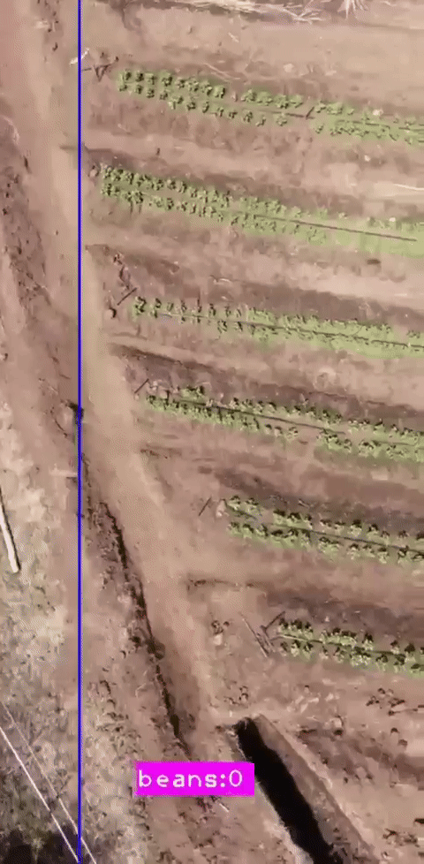

Major AI Developments and Innovations
Reinforcement Learning: AI agents learn to make decisions by interacting with an environment. Successes in game-playing (e.g., AlphaGo, AlphaFold) and robotics control.
Computer Vision: AI systems that accurately identify and analyze visual data. Tasks (object detection, facial recognition, medical imaging, etc.)

Slide 18
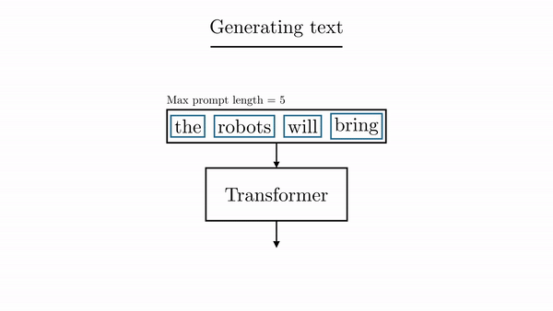
Major AI Developments and Innovations
Large Language Models (LLMs): Massive neural networks trained on vast textual data (e.g., GPTs, BERT, LaMDA, Claude). Capable of generating human-like text, answering questions, and understanding natural language
Generative AI: AI models that can create new content, such as images, videos, music, and code( e.g., DALL-E, Stable Diffusion, Midjourney (image generation), Mubert (music generation)

Slide 19
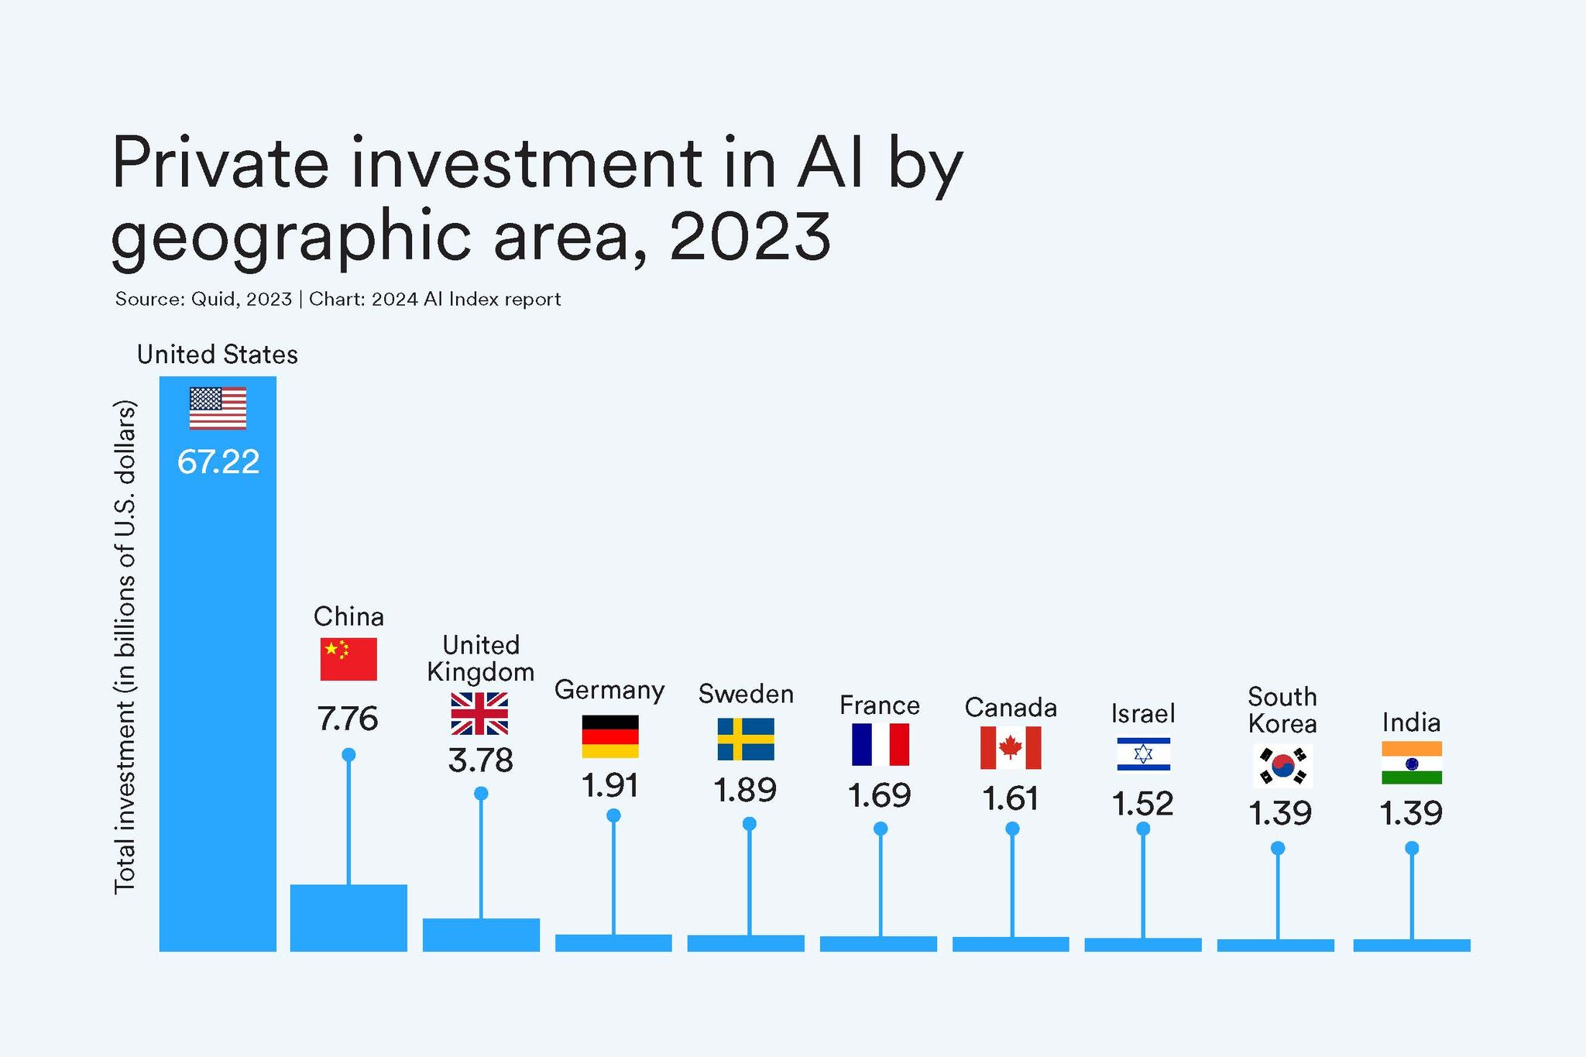
Leading Countries and Companies in AI
Leading Countries
United States - Home to AI giants like Google, Microsoft, Amazon, OpenAI, Meta
China - Rapid AI growth with companies like Baidu, Alibaba, Tencent
United Kingdom - Strong AI research centers and startups (DeepMind)
Germany - Emerging of AI hubs
France – Strong policy and the government invested heavily (e.g, Mistral AI, Huggingface)

Slide 20
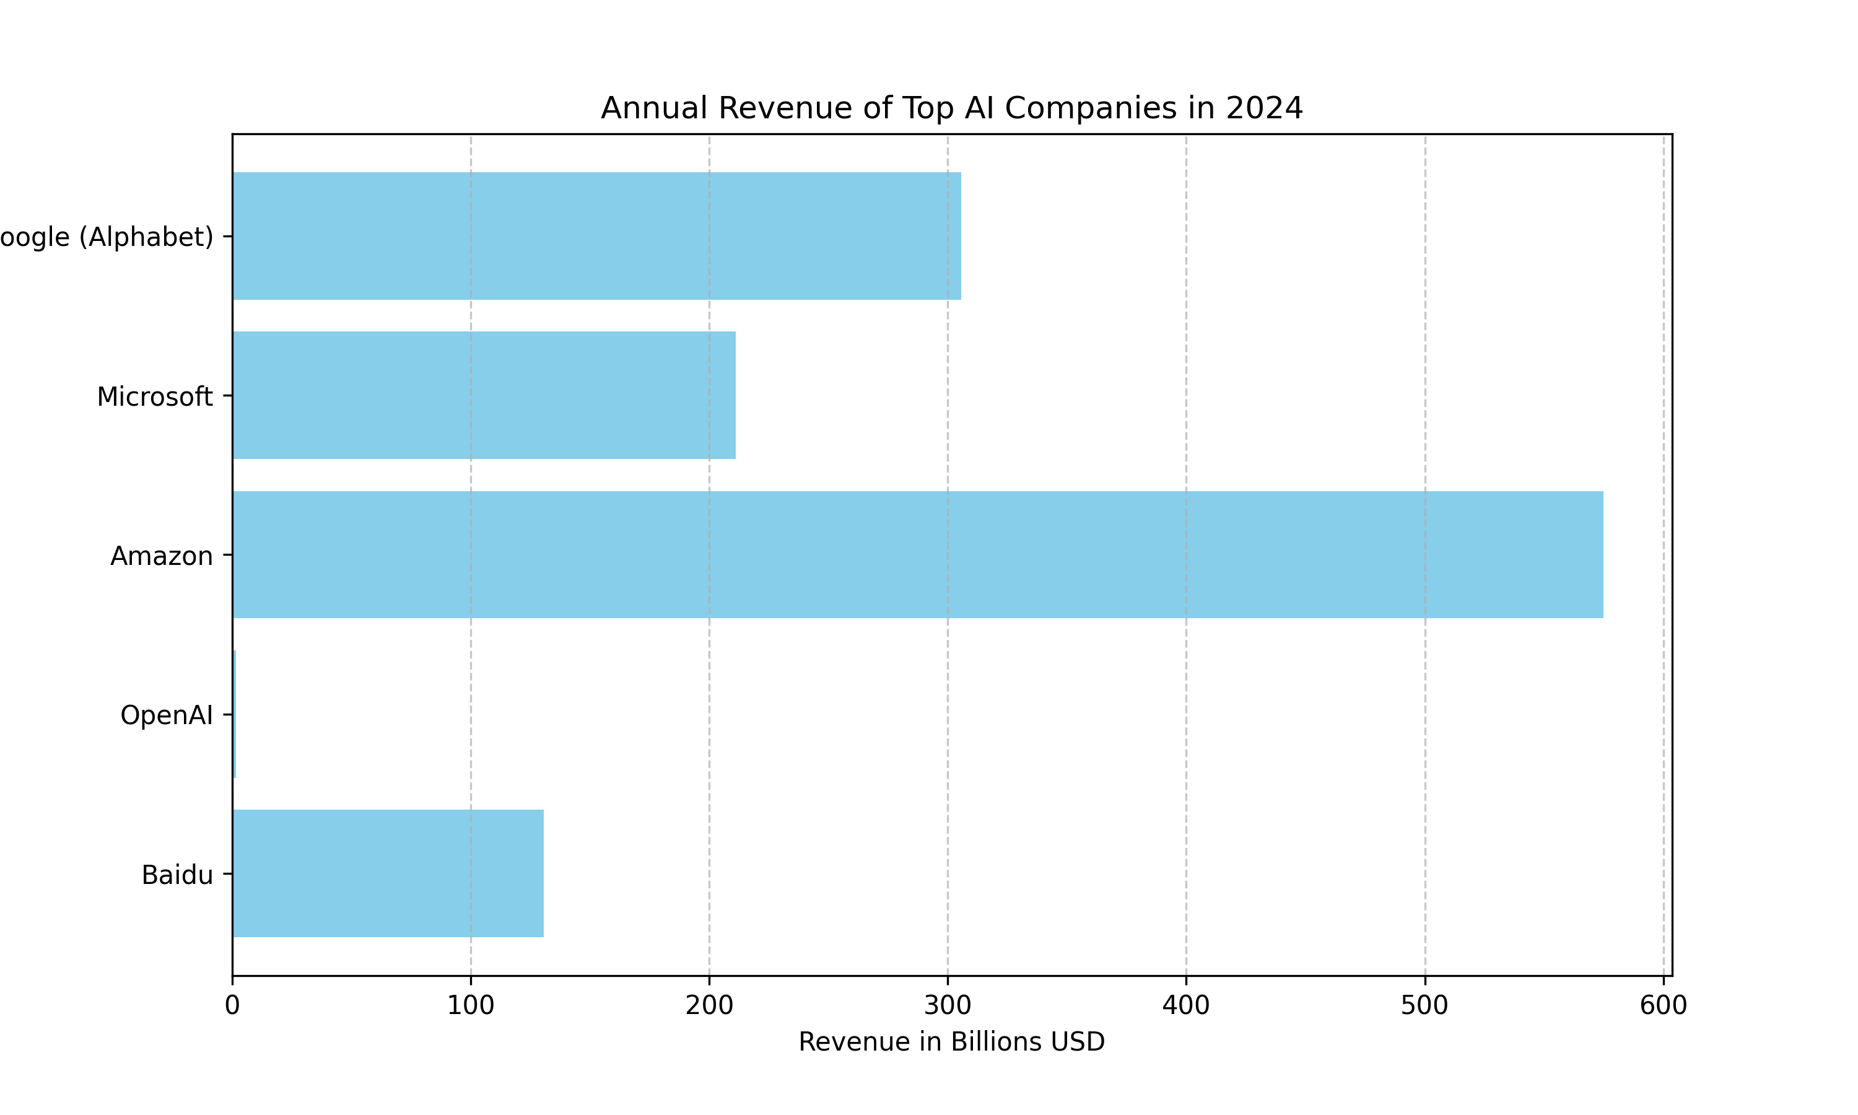





Leading Countries and Companies in AI
Companies
Google (Alphabet) - World leader in AI research and applications
Microsoft - AI cloud services, virtual assistants (Cortana)
Amazon - Alexa virtual assistant, AWS AI services
OpenAI - Pioneering AI research company, language models like GPT
Baidu - China's leading AI company for autonomous driving, natural language

Slide 21
Global Trends in AI Research and Applications
Multimodal AI: Integrating multiple data modalities (text, image, video, audio).
Explainable AI (XAI): Development of AI models that can explain their decision-making process.
AI for Climate Change and Sustainability.
AI in Healthcare: medical imaging, drug discovery, disease diagnosis, and personalized medicine. Potential to improve patient outcomes and healthcare accessibility
AI and Robotics: Integration of AI into robotic systems for automation, manufacturing, and service tasks
AI-powered cybersecurity: detecting and preventing cyber threats, malware, and anomalies
AI Ethics and Regulation: focus on responsible AI development and deployment
Quantum AI Exploration of combining quantum computing with AI for faster processing and problem-solving
Notes:
Multimodal AI: Integration of multiple data modalities (text, image, video, audio). Enables AI systems to perceive and understand the world more holistically.
Explainable AI (XAI): Development of AI models that can explain their decision-making process. Increases transparency, trustworthiness, and accountability of AI systems
AI for Climate Change and Sustainability Use of AI to address environmental challenges, such as carbon footprint reduction, natural resource management, and disaster prediction
AI in Healthcare: Applications in medical imaging, drug discovery, disease diagnosis, and personalized medicine. Potential to improve patient outcomes and healthcare accessibility
AI and Robotics: Integration of AI into robotic systems for automation, manufacturing, and service tasks
Collaborative robots (cobots) working alongside humans
AI-powered cybersecurity AI models for detecting and preventing cyber threats, malware, and anomalies
Enhancing security and protection against evolving cyber threats
AI Ethics and Regulation Increasing focus on responsible AI development and deployment
Ethical frameworks, guidelines, and regulations to mitigate risks and biases
Quantum AI Exploration of combining quantum computing with AI for faster processing and problem-solving
Potential breakthroughs in areas like optimization, simulation, and cryptography

Slide 22
AI in Tanzania: Current Landscape

Slide 23
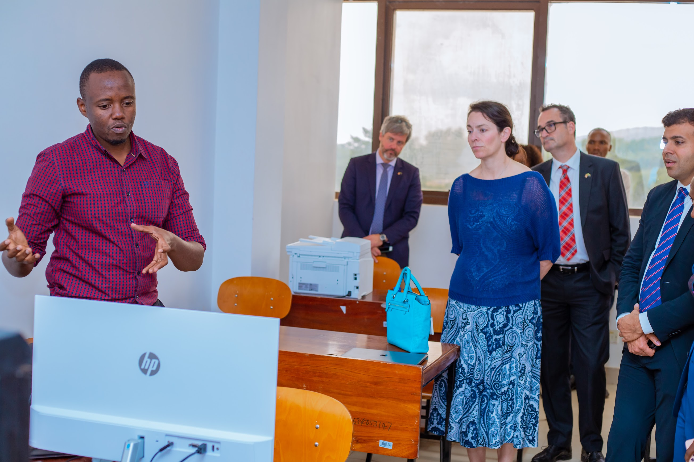
Existing AI Projects and Initiatives
Multidisciplinary AI4D Lab in Anglophone Africa
Organization: University of Dodoma, Sartify (Swahili AI)
Description: Strengthening the capacity of a public university to conduct high-quality, multidisciplinary, responsible AI research and teaching.
Resource:
Currently:A6000 Lambda GPU
Future: A100

Slide 24
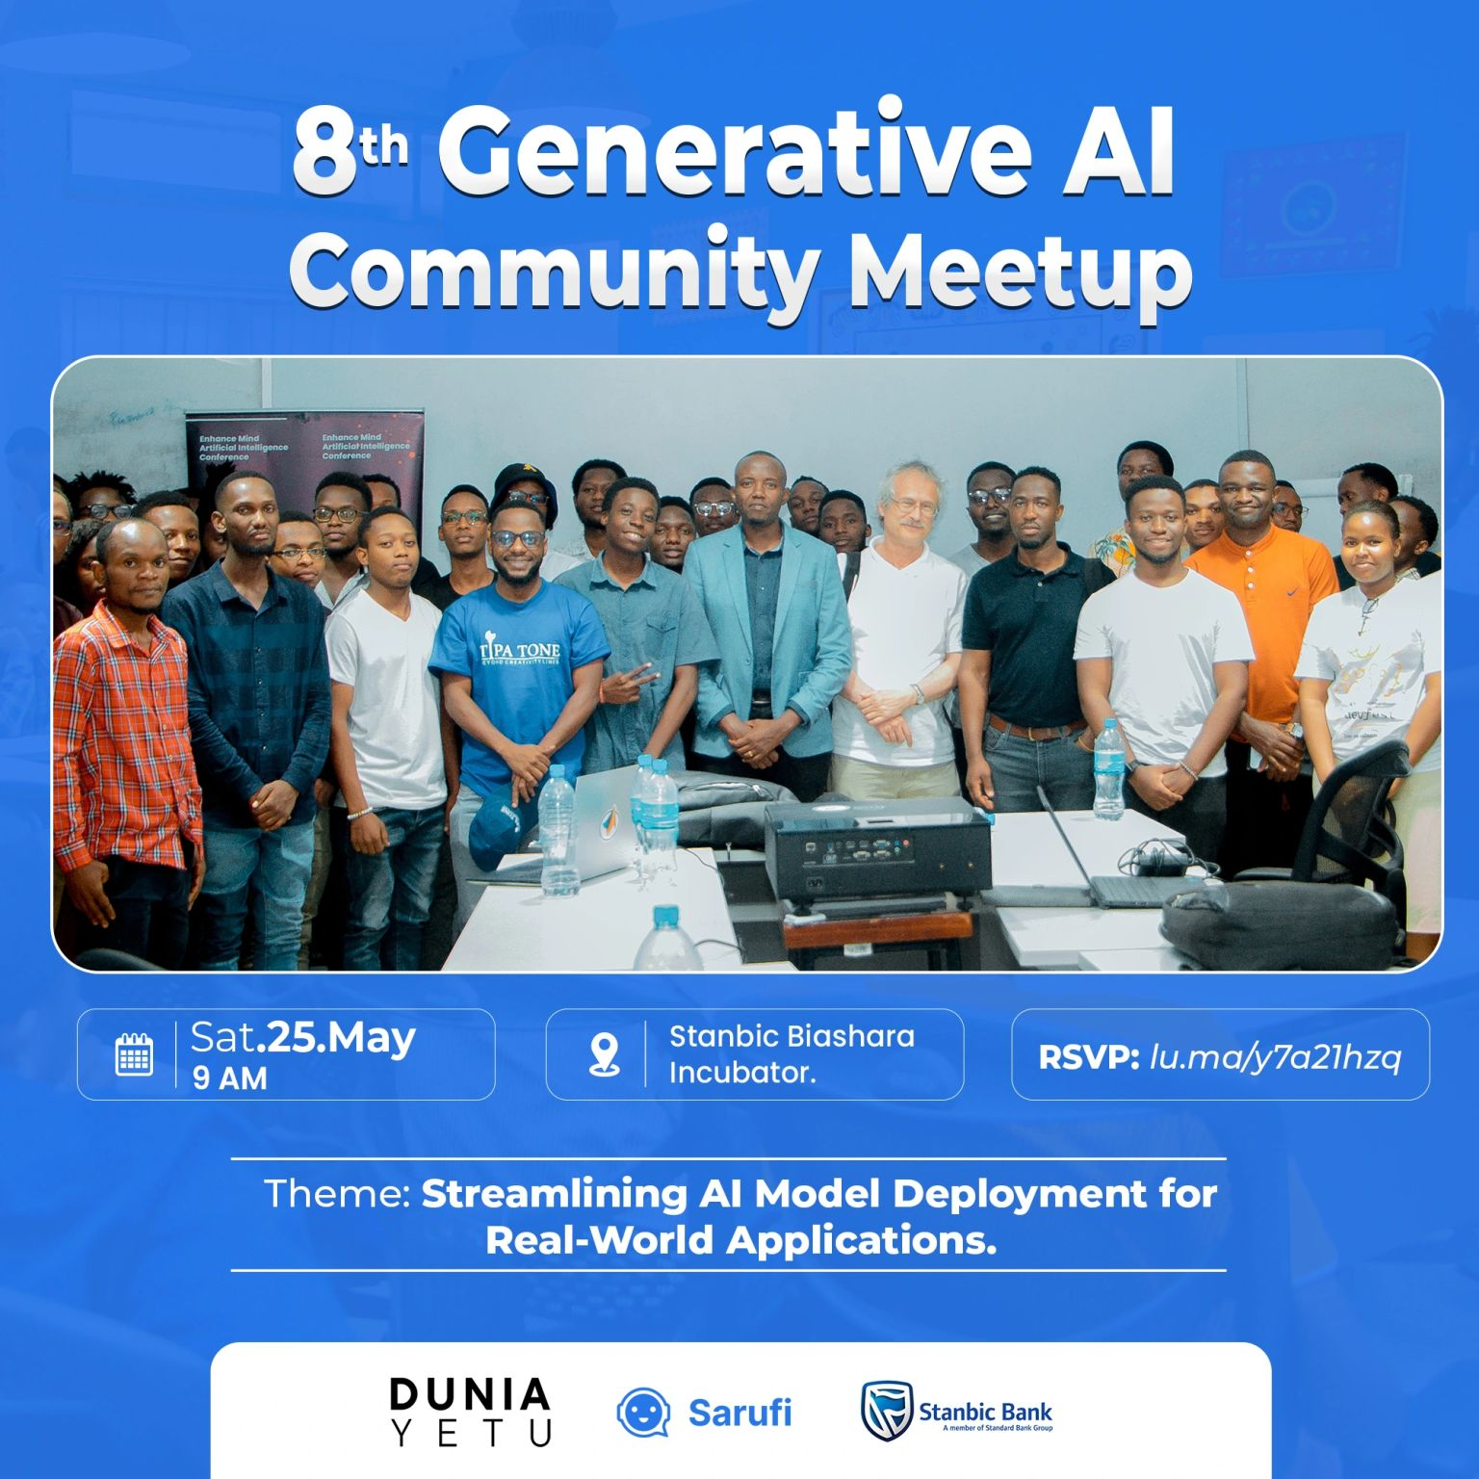
Existing AI Projects and Initiatives
Generative AI Community Meetup
Organizer: NeuroTech Africa, Sartify, etc,.
Description: Capacity building and sharing generative AI knowledge through coding sessions, hackathons, paper discussions, and other activities.
Resource:
Currently: Kaggle , Colab (GPU)
Future: Sartify (A6000)
Financial: Relies mainly on sponsorships

Slide 25
Existing AI Projects and Initiatives
AI in the Health Sector
Organization: Ministry of Health
Description: Implementing AI through the Centre for Digital Health (CDH) to support AI in clinical settings, biomedical research, and health system administration.
AI for Malaria Control
Organization: Ifakara Health Institute
Description: Using machine learning and mid-infrared spectroscopy to rapidly assess malaria mosquito blood-feeding histories and parasite infection rates.

Slide 26
Existing AI Projects and Initiatives
Leveraging the Capabilities of Artificial Intelligence for Transparency and Accountability in the Tendering Process and Project Follow-up to Drive Sustainable Development in Tanzania
Organizations: PCCB, COSTECH
Description: This initiative focuses on utilizing artificial intelligence (AI) to enhance transparency and accountability within Tanzania's tendering processes and project follow-up activities.
Mental Health AI Initiatives
Organizations: Overseas Development Institute (ODI), Tanzania, Vietnam
Description: Addressing the mental health needs of adolescents through the co-creation and application of digital technologies.

Slide 27
Government Policies and Support
National IT Policy Update Ongoing process to update the National IT Policy of 2004 (Prof Mkenda Friday Feb 9, 2024) (Nape Dec 20, 2023)
Aims to align the policy with current technological advancements, including AI
Ensures legal and regulatory frameworks are in place for responsible AI development
Policy Framework for Artificial Intelligence in Tanzania Health Sector (Health, Feb 2022).
Establishment of the Centre for Digital Health (CDH) to coordinate AI initiatives and ensure proper implementation in the health sector

Slide 28
Government Policies and Support
Infrastructure and Capacity
Building Investing in infrastructure, equipment, and expertise development
Construction of two smart IT colleges in Nala and Buhigwe regions
Establishing a center of excellence for AI and emerging technologies research at DIT
Integration of AI Education
Plans to incorporate IT and AI education into primary education curriculum
Equipping students with relevant knowledge from a young age
Ethical AI Development
Emphasis on managing the development of AI in line with Tanzanian values
Prioritizing ethical considerations and responsible AI practices

Slide 29
AI Research and Education in Tanzanian Universities
University of Dodoma - Dodoma (Multidisciplinary AI4D Lab)
The Nelson Mandela African Institution of Science and Technology – Arusha
University of Dar es Salaam
Courses
Data Science
Computer Science
Data Engineering
Online Resources
Stanford Online | Coursera
Khan Academy | Udacity
IBM Skills Network | Udemy
LinkedIn Learning | Fast.ai
Microsoft Learn | DataCamp
MIT OpenCourseWare | edX
Harvard Online Learning | Google AI

Slide 30
Applications of AI in Tanzania

Slide 31

Healthcare
1. Disease Diagnosis and Treatment
Early and accurate disease detection. Analysis of medical images (X-rays, CT scans, MRI) for diagnostic purposes. Development of personalized treatment plans based on patient data.
2. Drug Discovery and Development
Molecular modeling and drug design. Identification of potential drug candidates and their interactions. Accelerating the drug development process.
3. Remote Patient Monitoring
Use of AI and IoT devices for continuous monitoring of patient vitals. Early detection of health issues and proactive intervention. Enabling remote healthcare access in underserved areas
4. Health System Administration
5. Remote Patient Monitoring
6. Mental Health Support
7. Health System Administration
Notes:
Slide 13: Applications of AI in Healthcare in Tanzania
Disease Diagnosis and Treatment
Use of AI and machine learning for early and accurate disease detection
Analysis of medical images (X-rays, CT scans, MRI) for diagnostic purposes
Development of personalized treatment plans based on patient data
Drug Discovery and Development
Application of AI in molecular modeling and drug design
Identification of potential drug candidates and their interactions
Accelerating the drug development process
Epidemic and Pandemic Management
AI-powered modeling and forecasting of disease spread
Optimizing resource allocation and decision-making during outbreaks
Example: COVID-19 testing support (Ifakara Health Institute)
Health Data Management
AI-driven analysis of large healthcare datasets (electronic medical records, clinical notes)
Identification of patterns, trends, and potential risk factors
Improving patient care and healthcare system efficiency
Remote Patient Monitoring
Use of AI and IoT devices for continuous monitoring of patient vitals
Early detection of health issues and proactive intervention
Enabling remote healthcare access in underserved areas
Mental Health Support
AI-powered chatbots and virtual assistants for mental health counseling
Example: Addressing adolescent mental health needs through digital technologies
Health System Administration
AI-based optimization of resource allocation and scheduling
Streamlining processes and reducing administrative burdens
Example: Centre for Digital Health (CDH) initiatives

Slide 32

Agriculture
1. Precision Farming
Use of AI and machine learning for optimizing crop yields. Soil analysis, weather forecasting, and predictive modeling. Enabling precise application of water, fertilizers, and pesticides
2. Crop Monitoring and Disease Detection
Analysis of satellite and drone imagery. Early detection of crop diseases, pests, and nutrient deficiencies. Timely intervention and management of crop health.
3. Pest and Weed Control
AI-based identification and classification of pests and weeds. Targeted and efficient application of pesticides and herbicides. Reducing crop losses and environmental impact
4. Yield Prediction and Forecasting
6. Livestock Management
7. Supply Chain Optimization
8. Smart Farming Techniques
Notes:
Here's a suggested content for Slide 14: Agriculture:
Slide 14: Applications of AI in Agriculture
Precision Farming
Use of AI and machine learning for optimizing crop yields
Soil analysis, weather forecasting, and predictive modeling
Enabling precise application of water, fertilizers, and pesticides
Crop Monitoring and Disease Detection
AI-powered analysis of satellite and drone imagery
Early detection of crop diseases, pests, and nutrient deficiencies
Timely intervention and management of crop health
Pest and Weed Control
AI-based identification and classification of pests and weeds
Targeted and efficient application of pesticides and herbicides
Reducing crop losses and environmental impact
Yield Prediction and Forecasting
AI models for accurate prediction of crop yields
Factoring in weather patterns, soil conditions, and historical data
Supporting decision-making and resource allocation
Livestock Management
AI-enabled monitoring of livestock health and behavior
Optimizing feed and nutrition for improved productivity
Early detection of diseases and proactive treatment
Supply Chain Optimization
AI-driven optimization of agricultural supply chains
Efficient transportation, storage, and distribution of produce
Reducing waste and ensuring timely delivery to markets
Smart Farming Techniques
Integration of AI with IoT, drones, and sensor technologies
Automated farming processes (planting, irrigation, harvesting)
Improving efficiency, productivity, and sustainability

Slide 33

Education
1. Personalized Learning
Platforms tailor educational content to the needs of individual students. Adaptive learning systems adjust difficulty based on student performance with customized feedback.
2. Content Creation and Curation
AI tools for creating interactive and engaging educational materials. Automatic curation of learning resources based on curriculum and student needs. Facilitating access to high-quality content for teachers and students.
3. Administrative Automation
Automation of tasks such as scheduling, grading, and attendance tracking. Streamlining administrative processes to reduce educators' workload.
4. Intelligent Tutoring Systems
5. Language Translation and Accessibility
6. Early Intervention and Support
7. Virtual Classrooms and Online Learning
8. Teacher Professional Development
Notes:
Slide 15: Applications of AI in Education
Personalized Learning
AI-driven platforms tailor educational content to the needs of individual students.
Adaptive learning systems adjust difficulty based on student performance.
Customized feedback and study plans to enhance learning outcomes.
Administrative Automation
Automation of tasks such as scheduling, grading, and attendance tracking.
Streamlining administrative processes to reduce educators' workload.
Improved data management and analytics for better decision-making.
Intelligent Tutoring Systems
AI-powered tutors that provide personalized guidance and support.
Interactive learning experiences that adapt to student progress.
Enhancing student engagement and understanding.
Content Creation and Curation
AI tools for creating interactive and engaging educational materials.
Automatic curation of learning resources based on curriculum and student needs.
Facilitating access to high-quality content for teachers and students.
Language Translation and Accessibility
AI-based translation tools to support multilingual education.
Enhancing accessibility for students with disabilities through AI-driven assistive technologies.
Promoting inclusive education for all students.
Early Intervention and Support
AI systems to identify students at risk of falling behind.
Providing timely support and resources to address learning gaps.
Enhancing student retention and success rates.
Virtual Classrooms and Online Learning
AI-driven platforms for managing virtual classrooms and online courses.
Facilitating remote learning with interactive and personalized experiences.
Expanding access to education in rural and underserved areas.
Teacher Professional Development
AI-powered tools for ongoing teacher training and development.
Personalized professional learning plans based on individual teacher needs.
Supporting educators in staying updated with the latest teaching practices and technologies.

Slide 34

Finance
1. Fraud Detection
AI algorithms for real-time monitoring of transactions to identify fraudulent activities. Pattern recognition to detect unusual behavior and anomalies. Enhancing security and reducing financial losses for banks and customers.
2. Algorithmic Trading
Use of AI for high-frequency trading and market analysis. Identifying market trends and making trades based on predictive analytics. Improving investment strategies and financial performance.
3. Regulatory Compliance
Ensure compliance with financial regulations and standards. Monitoring transactions and reporting to regulatory bodies.
4. Customer Service Automation
5. Credit Scoring and Risk Assessment
6. Algorithmic Trading
7. Personalized Financial Planning
8 Cost Reduction and Efficiency
9. Customer Insights and Segmentation
Notes:
Slide 16: Applications of AI in Finance
Fraud Detection
AI algorithms for real-time monitoring of transactions to identify fraudulent activities.
Pattern recognition to detect unusual behavior and anomalies.
Enhancing security and reducing financial losses for banks and customers.
Customer Service Automation
AI-powered chatbots and virtual assistants for 24/7 customer support.
Handling routine inquiries, processing transactions, and providing personalized financial advice.
Improving customer experience and operational efficiency.
Credit Scoring and Risk Assessment
AI models for evaluating creditworthiness using a variety of data sources.
Providing more accurate and fair credit scoring than traditional methods.
Enhancing risk assessment and decision-making for loans and credit.
Algorithmic Trading
Use of AI for high-frequency trading and market analysis.
Identifying market trends and making trades based on predictive analytics.
Improving investment strategies and financial performance.
Personalized Financial Planning
AI tools for creating customized financial plans and investment strategies.
Analyzing individual financial behavior and preferences to provide tailored advice.
Helping individuals and businesses optimize their financial management.
Regulatory Compliance
AI systems for ensuring compliance with financial regulations and standards.
Monitoring transactions and reporting to regulatory bodies.
Reducing the risk of non-compliance and associated penalties.
Market Analysis and Forecasting
AI-driven analysis of financial markets and economic trends.
Predictive modeling to forecast market movements and economic indicators.
Supporting strategic planning and investment decisions.
Cost Reduction and Efficiency
Automation of routine financial tasks such as data entry, reconciliation, and reporting.
Reducing operational costs and improving efficiency in financial services.
Enabling financial institutions to focus on higher-value activities.
Customer Insights and Segmentation
AI tools for analyzing customer data to gain insights into behavior and preferences.
Segmentation of customers for targeted marketing and personalized services.
Enhancing customer engagement and satisfaction.

Slide 35

Public Services
1. Law Enforcement and Public Safety
Crime prediction and prevention, enhancing surveillance and monitoring for public safety. Efficient resource allocation for emergency response and disaster management.
2. Environmental Monitoring
Monitoring and managing environmental resources. Predictive analytics for weather forecasting and disaster management. Enhancing conservation efforts and sustainable resource utilization.
3. Efficient Public Administration
Automation of routine government processes and services. AI-driven public records management and resource allocation. Enhancing transparency and accountability in government operations.
4. Smart City Initiatives
5. Healthcare Services
6. Social Services and Welfare
7. Education Services
8. Public Transportation
Notes:
Slide 17: Applications of AI in Public Services
Smart City Initiatives
Implementation of AI for efficient management of urban infrastructure.
Traffic management systems to reduce congestion and improve safety.
Energy distribution and waste management optimized through AI.
Enhancing quality of life and sustainability in urban areas.
Efficient Public Administration
Automation of routine government processes and services.
AI-driven public records management and resource allocation.
Streamlining service delivery and reducing bureaucratic delays.
Enhancing transparency and accountability in government operations.
Healthcare Services
AI applications for diagnostics, treatment planning, and patient management.
Improving access to healthcare services through telemedicine and AI-driven health apps.
Early detection of diseases and personalized treatment plans.
Enhancing overall public health and medical care.
Law Enforcement and Public Safety
AI tools for crime prediction and prevention.
Enhancing surveillance and monitoring for public safety.
Efficient resource allocation for emergency response and disaster management.
Supporting law enforcement agencies with data-driven insights.
Environmental Monitoring
AI systems for monitoring and managing environmental resources.
Predictive analytics for weather forecasting and disaster management.
Enhancing conservation efforts and sustainable resource utilization.
Addressing climate change impacts and promoting environmental protection.
Education Services
AI-driven platforms for improving access to education.
Personalized learning experiences for students.
Automation of administrative tasks in educational institutions.
Enhancing the quality and reach of education across the country.
Social Services and Welfare
AI applications for efficient delivery of social services and welfare programs.
Identifying and targeting vulnerable populations for assistance.
Streamlining processes for benefits distribution and case management.
Improving the effectiveness and reach of social welfare initiatives.
Public Transportation
AI-driven systems for optimizing public transportation networks.
Enhancing route planning and scheduling for buses and trains.
Improving passenger experience and reducing operational costs.
Promoting sustainable and efficient public transport solutions.

Slide 36
Benefits of AI for Tanzanian Society

Slide 37
Economic Growth and Job Creation
Economic Growth
Job Creation
Increased Efficiency: AI technologies streamline processes in various sectors such as agriculture, manufacturing, and services, leading to higher productivity and economic output.
Innovation and New Industries: AI fosters innovation, leading to the creation of new industries and business models that can drive economic growth.
Attracting Investment: Adoption of AI can attract both local and international investments, boosting economic development.
New Job Opportunities: AI creates new job roles in technology development, data analysis, AI maintenance, and more.
Skill Development: AI necessitates the development of new skills and training programs, leading to a more skilled workforce.
Support for Entrepreneurs: AI provides tools and platforms that can help entrepreneurs and small businesses grow, creating more job opportunities.
Notes:
Certainly! Here are the texts for Slides 18, 19, and 20:
Slide 18: Economic Growth and Job Creation
Benefits of AI for Tanzanian Society
Economic Growth
Increased Efficiency: AI technologies streamline processes in various sectors such as agriculture, manufacturing, and services, leading to higher productivity and economic output.
Innovation and New Industries: AI fosters innovation, leading to the creation of new industries and business models that can drive economic growth.
Attracting Investment: Adoption of AI can attract both local and international investments, boosting economic development.
Job Creation
New Job Opportunities: AI creates new job roles in technology development, data analysis, AI maintenance, and more.
Skill Development: AI necessitates the development of new skills and training programs, leading to a more skilled workforce.
Support for Entrepreneurs: AI provides tools and platforms that can help entrepreneurs and small businesses grow, creating more job opportunities.

Slide 38
Improved Quality of Life
Healthcare Advances: AI improves diagnostic accuracy, personalizes treatment plans, and manages patient care more efficiently, leading to better health outcomes.
Education Access: AI-powered educational tools offer personalized learning experiences, increasing education quality and accessibility for all students.
Smart Agriculture: AI optimizes farming practices, improves crop yields, and enhances food security through predictive analytics and automated systems.
Convenience in Daily Activities: AI applications, such as virtual assistants and smart home devices, streamline daily tasks, enhance convenience, and save time.
Notes:
Slide 19: Improved Quality of Life
Benefits of AI for Tanzanian Society
Enhancements in Daily Life Due to AI
Healthcare Advances: AI improves diagnostic accuracy, personalizes treatment plans, and manages patient care more efficiently, leading to better health outcomes.
Education Access: AI-powered educational tools offer personalized learning experiences, increasing education quality and accessibility for all students.
Smart Agriculture: AI optimizes farming practices, improves crop yields, and enhances food security through predictive analytics and automated systems.
Convenience in Daily Activities: AI applications, such as virtual assistants and smart home devices, streamline daily tasks, enhance convenience, and save time.

Slide 39
Enhanced Public Services
Intelligent Transportation Systems
AI-powered traffic management for reduced congestion. Optimized public transit routes and schedules. Predictive maintenance of transportation infrastructure.
E-Governance and Digital Services
AI-powered citizen support chatbots and virtual assistants. Automated processing of applications and paperwork. AI for fraud detection and cybersecurity in e-gov systems
Urban Planning and Development
Sustainable urban growth and land use. Predictive analytics for infrastructure maintenance. Smart city simulations for policy decision support.
Environmental Monitoring and Protection
Air/water quality monitoring, wildlife conservation, and forest management. Predictive modeling of environmental risks and disasters
Notes:
Slide 20: Enhanced Public Services
Intelligent Transportation Systems
AI-powered traffic management for reduced congestion
Optimized public transit routes and schedules
Predictive maintenance of transportation infrastructure
Smart City Solutions
AI for efficient energy distribution and utility management
Automated waste collection and recycling systems
AI-enabled public safety and emergency response
E-Governance and Digital Services
AI-powered citizen support chatbots and virtual assistants
Automated processing of applications and paperwork
AI for fraud detection and cybersecurity in e-gov systems
Urban Planning and Development
AI modeling for sustainable urban growth and land use
Predictive analytics for infrastructure maintenance
Smart city simulations for policy decision support
Environmental Monitoring and Protection
AI systems for air/water quality monitoring
AI for wildlife conservation and forest management
Predictive modeling of environmental risks and disasters

Slide 40
Challenges and Ethical Considerations

Slide 41
Data Privacy and Security
Data Breaches: The increasing amount of data collected by AI systems raises the risk of data breaches, which can lead to the exposure of sensitive information.
Personal Privacy: AI applications often require vast amounts of personal data, which can threaten individual privacy if not appropriately managed.
Informed Consent: Transparency in data collection, usage, and storage practices
Regulatory Compliance: Navigating the complex landscape of data protection regulations, such as GDPR and other local laws, is essential to ensure legal compliance.
Security Measures: Implementing robust security measures to protect data from unauthorized access and cyber threats is a significant challenge.
Ethical Use of Data: data is used ethically, without discrimination or bias, and is critical to maintaining the integrity of AI systems.
Notes:
The General Data Protection Regulation (GDPR) is a comprehensive data protection law enacted by the European Union (EU). It came into effect on May 25, 2018, and it aims to give EU citizens greater control over their personal data and to unify data protection laws across all EU member states. Here are the key aspects of GDPR:
Scope: GDPR applies to all organizations, regardless of their location, if they process personal data of individuals within the EU. This includes companies based outside the EU that offer goods or services to, or monitor the behavior of, EU residents.
Personal Data: It defines personal data broadly as any information relating to an identified or identifiable natural person. This includes names, email addresses, location data, online identifiers, and more.
Data Subject Rights: GDPR grants individuals several rights over their personal data, including:
Right to Access: Individuals can request access to their personal data and information on how it is being used.
Right to Rectification: Individuals can request corrections to their personal data if it is inaccurate or incomplete.
Right to Erasure (Right to be Forgotten): Individuals can request the deletion of their personal data under certain circumstances.
Right to Restrict Processing: Individuals can request that their data be restricted from processing under certain conditions.
Right to Data Portability: Individuals can request to receive their personal data in a commonly used format and transfer it to another data controller.
Right to Object: Individuals can object to the processing of their personal data in certain situations, including for direct marketing purposes.
Lawful Basis for Processing: Organizations must have a valid legal basis to process personal data. The lawful bases include consent, performance of a contract, compliance with a legal obligation, protection of vital interests, public task, and legitimate interests.
Consent: When consent is the legal basis for data processing, it must be freely given, specific, informed, and unambiguous. Consent must also be as easy to withdraw as it is to give.
Data Protection Officer (DPO): Certain organizations are required to appoint a Data Protection Officer to oversee compliance with GDPR, especially those that engage in large-scale processing of sensitive data or systematic monitoring of individuals.
Data Breach Notifications: Organizations must report certain types of data breaches to the relevant supervisory authority within 72 hours of becoming aware of the breach. If the breach poses a high risk to the affected individuals, they must also be informed.
Penalties: Non-compliance with GDPR can result in significant fines. The maximum fines can be up to €20 million or 4% of the annual global turnover of the preceding financial year, whichever is higher.

Slide 42
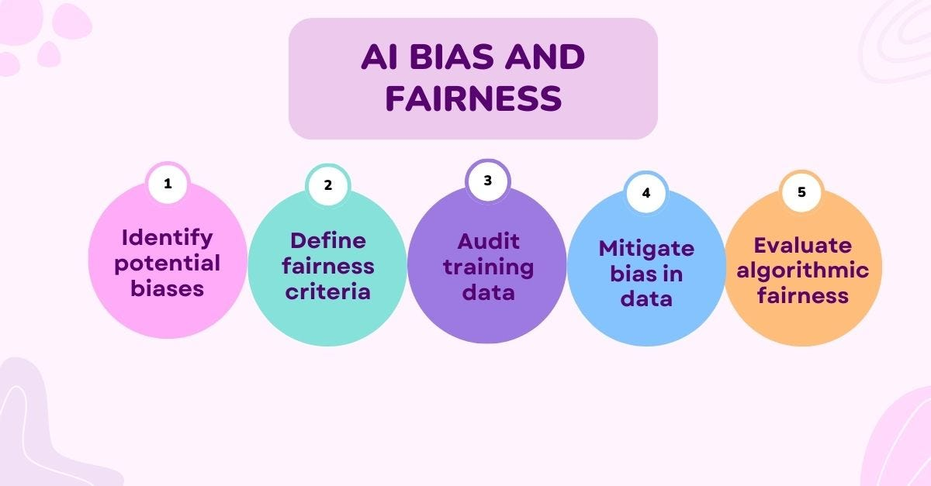
Bias and Fairness in AI Algorithms
AI models can inherit and amplify societal biases from training data.
Risks of discrimination against underrepresented groups.
Importance of diverse and representative data for AI training.
Algorithmic auditing for bias detection and mitigation.
Promoting inclusive AI development teams and processes.
Notes:
Slide 22: Bias and Fairness in AI Algorithms
AI models can inherit and amplify societal biases from training data
Risks of discrimination against underrepresented groups
Importance of diverse and representative data for AI training
Algorithmic auditing for bias detection and mitigation
Promoting inclusive AI development teams and processes

Slide 43
Socio-Economic Disparities
Unequal access to AI technologies across different income levels
Cost of AI solutions may limit adoption for low-income communities. The digital divide exacerbates existing socioeconomic gaps.
Differential impact of AI-driven job displacement
Risk of disproportionate job losses for specific sectors/workers. Need for reskilling and economic transition support programs
Lack of representation in AI development
Underrepresented groups
Uneven distribution of AI-enabled services and opportunities
Urban-rural divide
Resource Allocation
AI-driven resource allocation systems may unintentionally favor well-off communities if not carefully designed and monitored.
Notes:
Unequal access to AI technologies across different income levels Cost of AI solutions may limit adoption for low-income communities
Digital divide exacerbating existing socio-economic gaps
Differential impact of AI-driven job displacement Risk of disproportionate job losses for certain sectors/workers
Need for reskilling and economic transition support programs
Lack of representation in AI development AI algorithms risk perpetuating biases against underrepresented groups
Importance of diversity in AI teams and inclusive design practices
Uneven distribution of AI-enabled services and opportunities Urban-rural divide in access to AI-powered services (healthcare, education etc.)
Targeted efforts needed to extend AI benefits equitably
Ethical imperative for inclusive AI development Mitigating risks of AI widening socio-economic inequalities
Promoting fairness, non-discrimination and equal opportunities

Slide 44
Regulatory and Legal Frameworks
Current Regulations
Limited existing AI-specific regulations globally and in Tanzania.
Data protection laws (e.g. data privacy, cybersecurity) applicable to AI systems.
Sectoral regulations for certain AI use cases (e.g. healthcare, transportation)
Needed Regulations
Comprehensive national AI governance framework and strategy
Legislation for algorithmic accountability and transparency
Ethical guidelines and standards for AI development and deployment
Legal frameworks for AI intellectual property and liability
Cross-border data sharing and interoperability standards

Slide 45
Regulatory and Legal Frameworks
Regulatory Challenges
Striking the balance between promoting innovation and public interest
Keeping pace with rapidly evolving AI technologies and use cases
Harmonizing international AI governance norms and best practices
Building regulatory expertise and capacity for AI oversight
Key Considerations
Multi-stakeholder collaboration (government, industry, civil society)
Risk-based and flexible regulatory approaches
Promoting public awareness, trust, and adoption of AI solutions
Continuous monitoring and updating of regulations

Slide 46
Strategies for Advancing AI in Tanzania

Slide 47
Strengthening AI Education and Training
Curriculum Development: Integrate AI and data science into the national education curriculum at all levels.
Teacher Training: Provide specialized training for educators to teach AI concepts effectively.
Scholarships and Grants: Offer scholarships and grants to students pursuing AI-related studies.
Online Courses and Resources: Promote access to online courses and educational resources on AI.
Workshops and Seminars: Organize workshops and seminars to raise awareness and build skills in AI among students and professionals.
Industry Partnerships: Collaborate with industry leaders to provide practical training and internship opportunities.

Slide 48
Encouraging Public-Private Partnerships
Joint Research Initiatives: Foster partnerships between academic institutions, government agencies, and private companies for AI research projects.
Innovation Hubs: Establish innovation hubs and incubators to support AI startups and entrepreneurs.
Funding Opportunities: Create programs encouraging private sector investment in AI projects.
Knowledge Sharing: Facilitate knowledge sharing and best practice exchanges between public and private sectors.
Pilot Projects: Implement pilot projects to test and showcase AI applications in various industries.
Mentorship Programs: Develop mentorship programs where experienced AI professionals guide and support emerging talent.

Slide 49
Investing in AI Research and Development
Government Funding: Increase government funding for AI research and development initiatives.
Infrastructure Development: Invest in the necessary infrastructure, such as high-performance computing facilities and data centers.
Grants and Scholarships: Provide grants and scholarships for researchers and students in the AI field.
Collaborative Projects: Encourage collaborative research projects between universities and industries.
International Collaboration: Partner with international organizations and institutions to leverage global expertise and resources.
Research Institutions: Establish and support AI research institutions and labs.

Slide 50
Creating Supportive Policies and Regulations
Regulatory Framework: Develop a comprehensive regulatory framework that addresses AI ethics, data privacy, and security.
Standards and Guidelines: Establish standards and guidelines for the development and deployment of AI technologies.
Ethical AI Practices: Promote ethical AI practices through policies that ensure fairness, transparency, and accountability.
Public Awareness: Raise public awareness about the benefits and risks of AI through education and communication campaigns.
Support for Innovation: Implement policies that encourage innovation and reduce barriers to AI development.
Monitoring and Evaluation: Set up mechanisms for monitoring and evaluating the impact of AI policies and regulations.

Slide 51
Future Outlook

Slide 52
Potential Future Applications of AI in Tanzania
Smart Agriculture: Advanced AI systems could optimize agricultural practices, from precision farming to automated harvesting, significantly boosting productivity and sustainability.
Healthcare Innovations: AI could enable predictive healthcare, personalized treatment plans, and advanced telemedicine services, improving overall health outcomes.
Education Enhancement: AI-driven adaptive learning platforms could provide personalized education experiences, addressing individual student needs and promoting lifelong learning.
Smart Cities: Implementing AI in urban planning could enhance traffic management, energy efficiency, and public safety, creating more sustainable and livable cities.
Environmental Conservation: AI could be used for monitoring and protecting natural resources, predicting environmental changes, and mitigating the impact of climate change.
Financial Inclusion: AI-powered financial services could reach underserved populations, offering accessible and secure banking solutions.

Slide 53
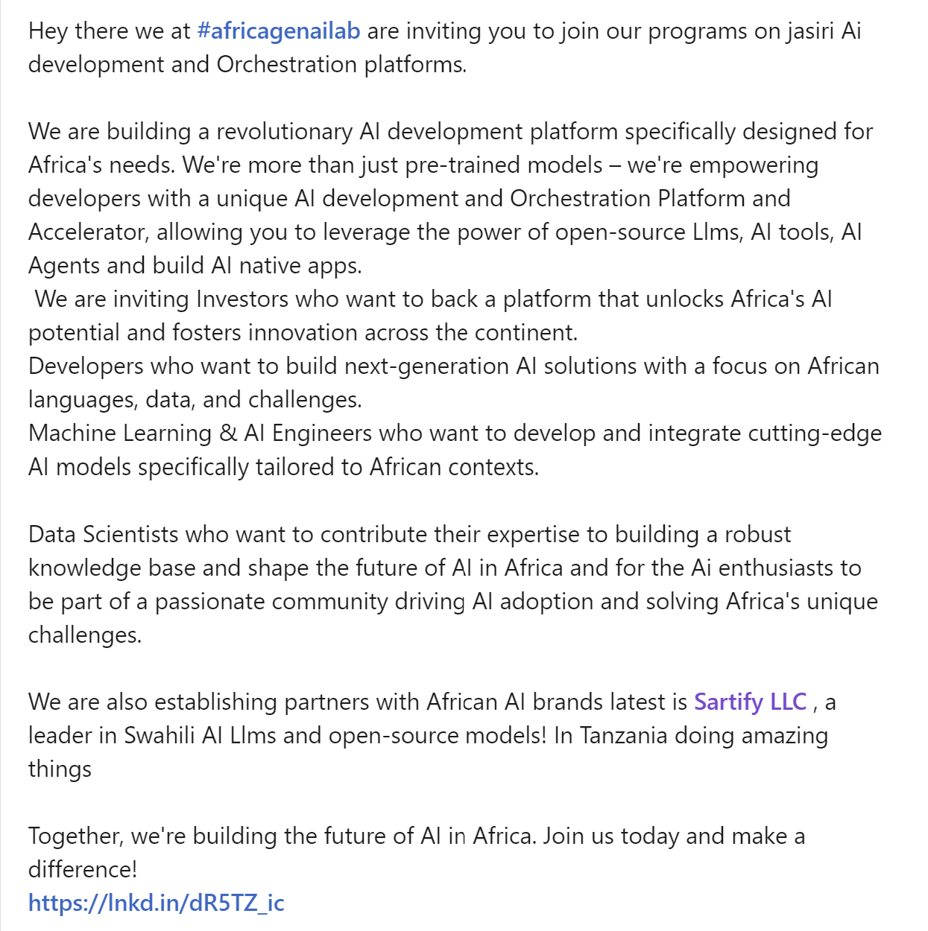
Vision for the Next Decade
Inclusive Growth: Ensure that the benefits of AI are shared across all socio-economic groups, reducing inequality and fostering inclusive economic growth.
Global Competitiveness: Position Tanzania as a leader in AI innovation in Africa, attracting international partnerships and investments.
Sustainable Development: Leverage AI to address key sustainable development goals, including poverty reduction, healthcare access, and environmental sustainability.

Slide 54
Vision for the Next Decade
Education and Workforce Development: Build a highly skilled workforce capable of driving AI advancements and adapting to technological changes.
Robust AI Ecosystem: Develop a supportive ecosystem with strong regulatory frameworks, research institutions, and industry collaborations.
Ethical AI Practices: Promote the ethical use of AI, ensuring fairness, transparency, and accountability in all AI applications.
Resilient Infrastructure: Invest in the necessary infrastructure for AI deployment, including high-speed internet, data centers, and computational resources.

Slide 55
Conclusion

Slide 56
Recap
Understanding AI and its components.
The current state of AI is global and in Tanzania.
Applications and benefits of AI in various sectors in Tanzania.
Challenges and ethical considerations of AI implementation.
Strategies for advancing AI in Tanzania.

Slide 57
Thoughts on the Role of AI in Tanzania's Future
AI is a powerful tool that can drive innovation and development across various sectors in Tanzania.
Emphasizing the need for responsible and ethical AI practices to ensure inclusivity and fairness.
Highlighting the importance of continued investment in AI research, education, and infrastructure.
Encouraging collaboration between public and private sectors to leverage AI for sustainable development.

Slide 58

Job Opportunity
Notes:
innocent@sartify.com

Slide 59

Q&A Session

